Slide 1
Group 1
Experiment 1
Presented by Charles Slagal

Slide 2
Experiment number 1
Group 1
Participants:
Charles Slagal
Jeanie Hess
Brandon Steup
Abdulrahman Almarwan
Charity Fischer

Slide 3
Experiment number 1
Group 1
Objective: To find the relationship between the displacement and the mass
Equipment: Pascal board, Pascal graduated spring scale, weights, hanger

Slide 4
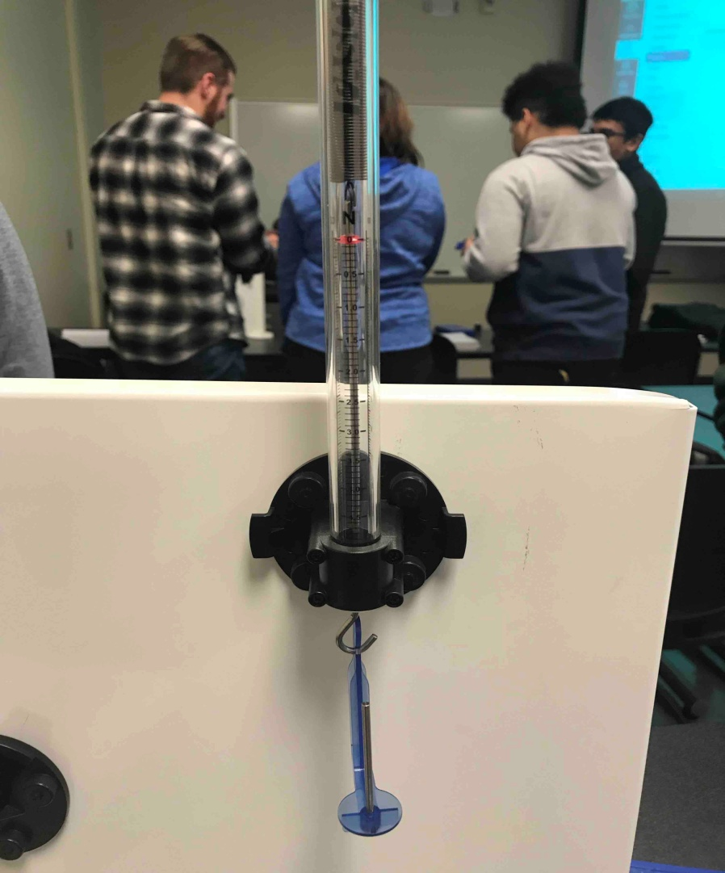
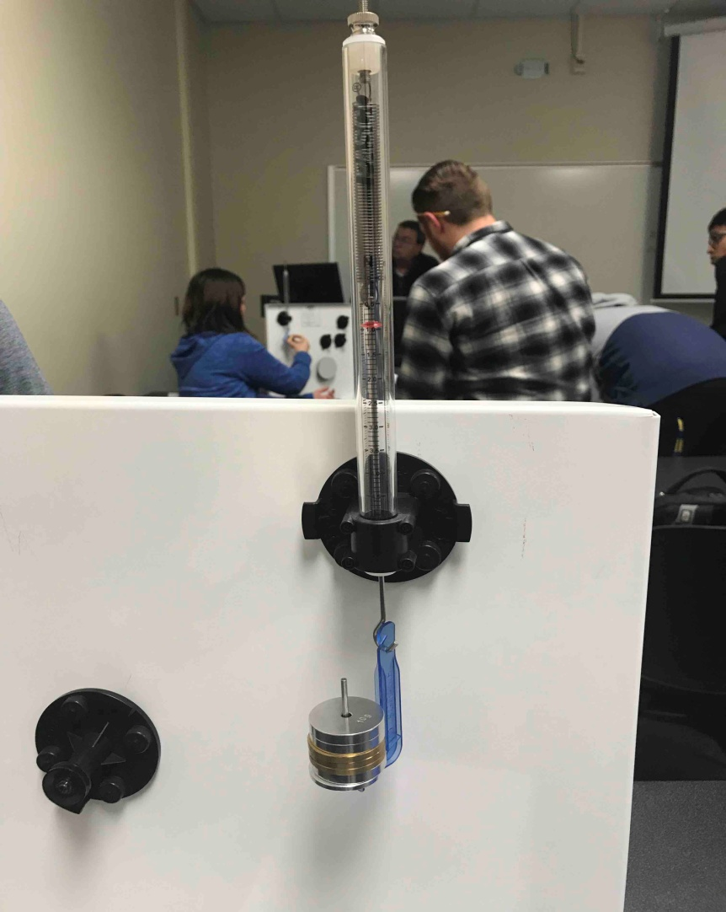
Experiment number 1
Group 1

Slide 5
Experiment number 1
Group 1
Results:

Slide 6
Experiment number 1
Group 1
Observations:
While it was a linear the real-life data skewed just a little

